Slide 1
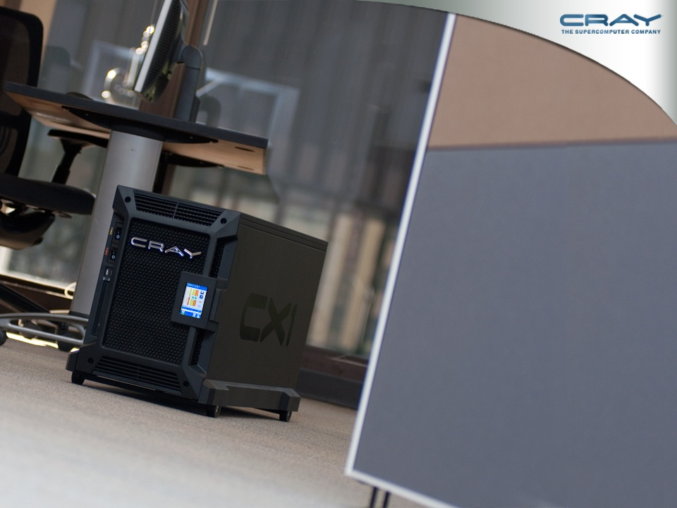
The Power in your hands -
The Cray CX1

Slide 2


What do you do? When….
Deadlines get tighter
You need to provide ever more accurate or detailed results
The application you are using cannot complete the job with your local resources – now you have to send your problem to the cluster
Your manager calls and wants the model rerun with new assumptions and wants results in two hours!
When the results matter and time is tight,
you need the right tool to get the job done:
You need to put the power in your hands!

Slide 3
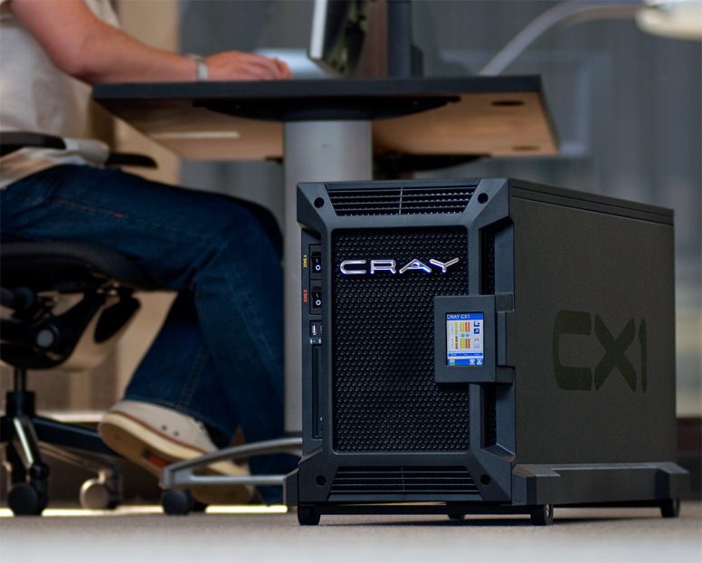
Putting the power in your hands
The Cray CX1 puts massive power and flexibility right where you need it
– in your workgroup
Up to 64 cores of Intel 5500 compute power
2D and 3D visualization
Up to 16TB of storage
GPU acceleration
Small footprint
Uses normal office power
Active noise suppression

Slide 4

You want Power? - A Teraflop in your office
Only five years ago the CX1 would have been on the top 500 list of the worlds most powerful computers
Applications now demand more power than other standard office systems can deliver – you no longer can do the whole job at your desk
Today, The Cray CX1 puts that power in your hands to get the job done quickly and reliably – making you a master of productivity

Slide 5
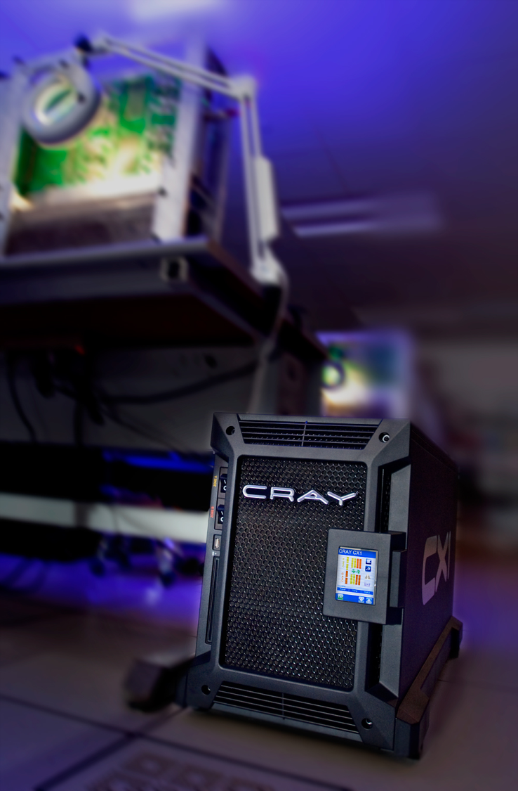
So, how does the CX1 deliver this productivity?
Easy to configure
Easy to install
Easy to use
Easy to maintain
Flexible options

Slide 6
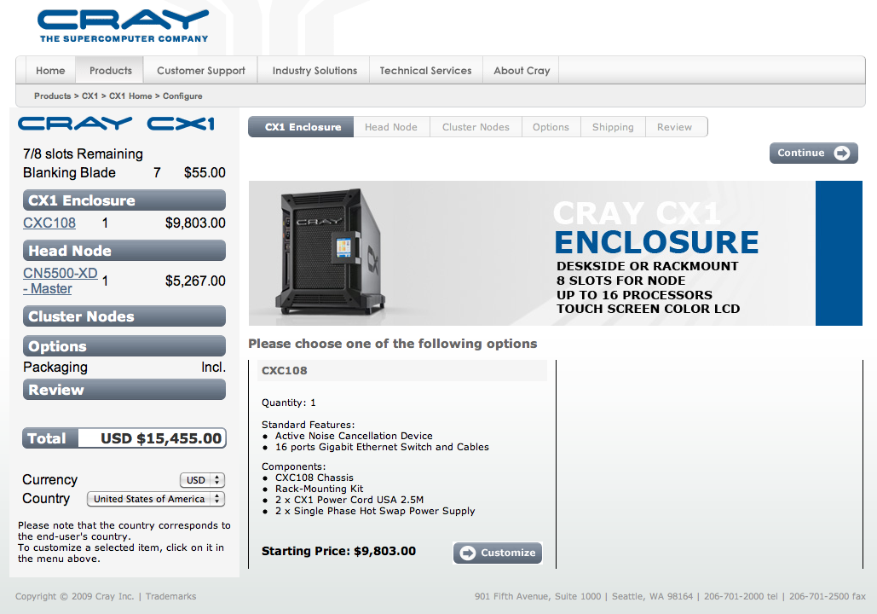
Easy to configure
The on-line configurator is easy to use
Allows you to add blades and options
See the price as you build up the system

Slide 7
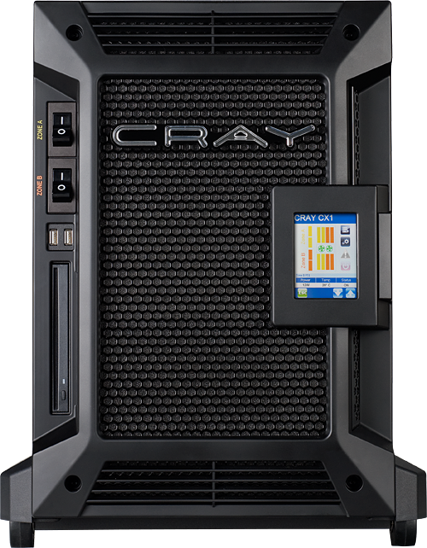
Easy to configure – The Chassis
Functional Form Factor
Deskside or Rack-mounted
Office Power Compliant
Usage of regular office power (20Amp/110V or 16A/240V)
Superior Power Efficiency (92%+)
LCD Color Touch Screen
Management Tools
Open Office Noise Level
NR45 Office Compliance

Slide 8
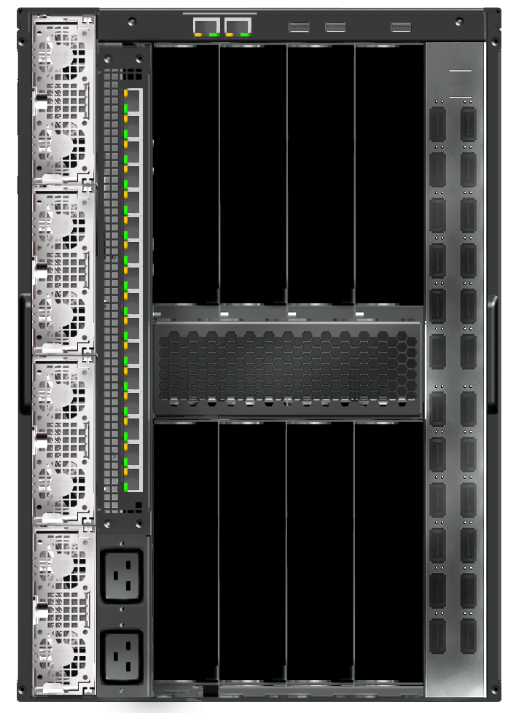
Easy to configure – The Chassis
Std. 16 Ports Gigabit Switch
Unmanaged Layer 2
External Ports
2 x RJ45
3 x USB
Zone 1 Power Supply Module
N+1 (opt. Redundancy)
Zone 1 Power Outlet
20Amp 110/240V
Opt. InfiniBand Switch
12 or 24 Ports DDR/QDR 4x
Zone 2 Power Outlet
20Amp 110/240V
Zone 2 Power Supply Module
N+1 (opt. Redundancy)
Zone 1 – 4 Nodes Slot
Accepts any Compute/Visualization/GPU- Compute/Storage Node
Zone 2 – 4 Nodes Slot
Accepts any Compute/Visualization/GPU- Compute/Storage Node
8 Blade slots in total per chassis

Slide 9

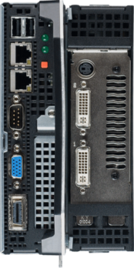
Easy to configure – The blades
Compute Blade
Dual socket Intel 5500 blade (8 Cores)
On board Infiniband and Gigabit Ethernet
Up to 96 GB memory
Maximum of 8 per CX1 chassis
Visualization Blade
Dual socket Intel 5500 blade (8 Cores)
Plus NVIDIA graphics card
On board Infiniband and Gigabit Ethernet
Up to 96 GB memory
Maximum of 4 per CX1 chassis

Slide 10
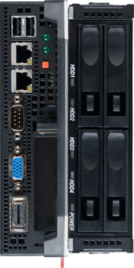
Easy to configure – The blades
GPU Blade
Dual socket Intel 5500 blade (8 Cores)
Plus NVIDIA Tesla C1060
On board Infiniband and Gigabit Ethernet
Up to 96 GB memory
Maximum of 4 per CX1 chassis
Storage Blade
Dual socket Intel 5500 blade (8 Cores)
Plus 4TB of storage
On board Infiniband and Gigabit Ethernet
Up to 96 GB memory
Maximum of 4 per CX1 chassis

Slide 11
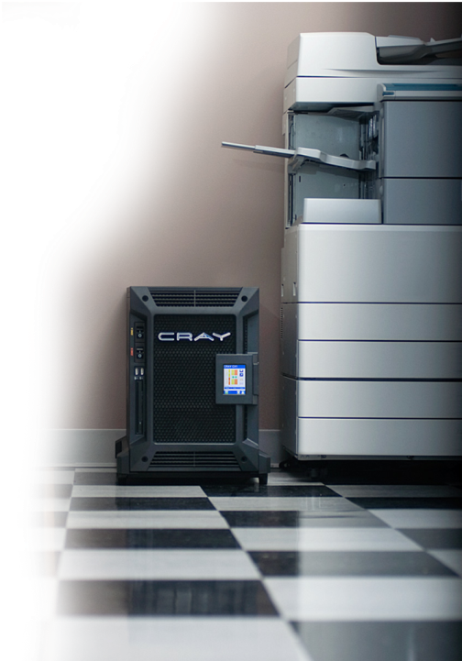

Easy to configure – build to order example 1
Compute Intensive Application Configuration
8 x
All compute – best for scale out parallel applications running MPI
16 processors giving 64 Intel 5500 cores with up to 768GB of memory

Slide 12
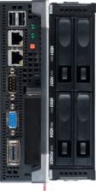
Easy to configure – build to order example 2
Memory Intensive Application Configuration
6 x
Mixed functionality for the workgroup – best for a team needing storage
14 processors giving 46 Intel 5500 cores with up to 672GB of memory
plus 4TB of storage and a 16 port inbuilt Ethernet switch for team members to connect through
1 x

Slide 13
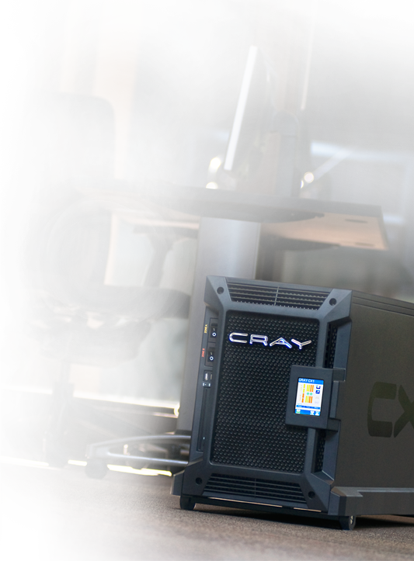
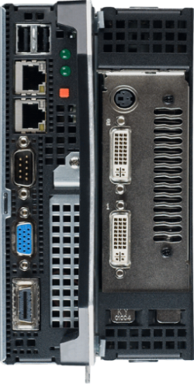
Easy to configure – build to order example 3
Visualization Application Configuration
4 x
Mixed functionality for the workgroup – 3D visualization with compute power
14 processors giving 46 Intel 5500 cores with up to 672GB of memory
plus NVIDIA Quadro FX graphics for team members to connect through
2 x

Slide 14
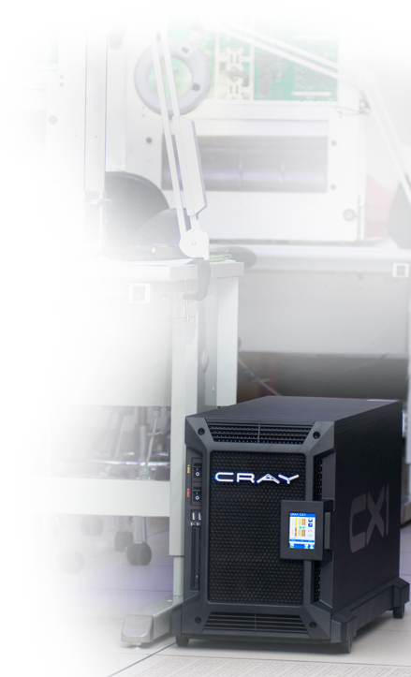
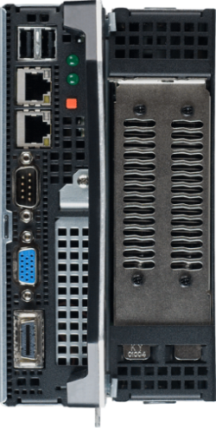
Easy to configure – build to order example 4
GPU Acceleration Application Configuration
4 x
GPU for the workgroup – best for a team needing GPU Acceleration
8 processors giving 16 Intel 5500 cores with up to 384GB of memory
plus NVIDIA Tesla GPU acceleration totaling 960 cores for team members to connect through

Slide 15
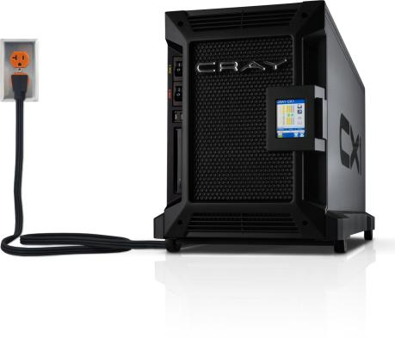
Easy to configure – build to order example 5
Configure the system to match your needs
2 x
Some of everything for the workgroup – build the system your team needs
8 processors giving 16 Intel 5500 cores with up to 384GB of memory
Plus 4TB of storage
Plus NIDIA Quadro FX visualization
plus NVIDIA Tesla GPU acceleration
All for your team to share
1 x
1 x
1 x

Slide 16


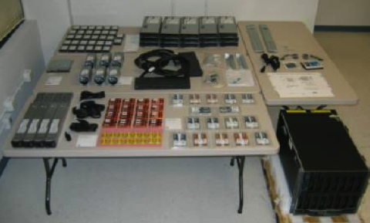


Easy To Install
The Cray CX1 system ships on a single pallet and can be assembled, loaded and run by a non-technician in about an hour – your choice:
OR

Slide 17

Easy To Install
The Cray CX1 supports Windows HPC Server 2008
Makes it easy to integrate HPC functionality into the corporate network
Single login through Active Directory
Makes accessing HPC services as easy as getting to email (Exchange), SharePoint or other services
Windows HPC server provides an entire HPC environment (scheduling, cluster management etc) built on the Windows Server platform

Slide 18

Easy To Install
The Cray CX1 supports Linux plus Platform Workgroup Manager
Traditional HPC users can leverage a comprehensive tool set including:
  Platform LSF for scheduling
  The Platform MPI library for applications compatibility (formerly Scali and HP-MPI)
  Platform ISF Adaptive Cluster – allowing for multi-boot capability with Windows and Linux

Slide 19
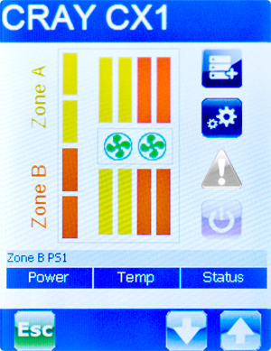

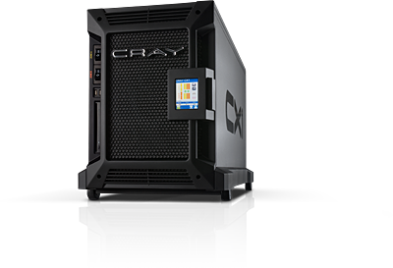
Easy to Use
Ease of use in HPC is about easy systems management as well as access to the applications you need to do the job
The Cray CX1 is easy to manage:
  Right from your desktop
  Or through a touch screen window in the front of the chassis
  Or Remotely through IPMI

Slide 20







Easy to Use
The Cray CX1’s ability to support Windows HPC Server 2008 and Linux (with Intel Cluster Ready certification) delivers the broadest possible library of commercial operating systems
Ease of use is about being able to run the applications you need, confident in their successful implementation
Cray partners closely with leading ISV’s in HPC to deliver the most comprehensive set of HPC applications

Slide 21
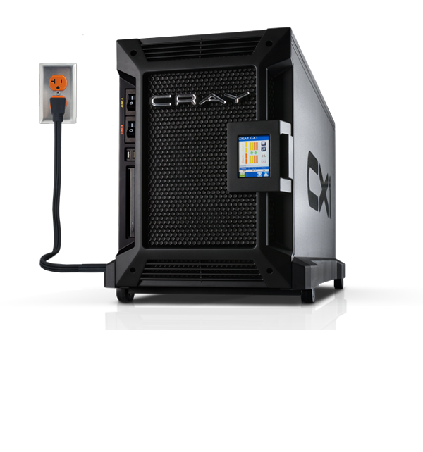
Easy to Use – In The Open Office
Ease of use is about being able to use the system without special power or data center infrastructure
The Cray CX1 plugs into normal 20A office power
The Cray CX1 has active noise suppression which makes it appreciably quieter than competing systems
Table of sound levels L and corresponding sound pressure
Examples | Sound Pressure Level L_{p} dBSPL
Jet aircraft, 50 m away | 140
Threshold of pain | 130
Threshold of discomfort | 120
Chainsaw, 1 m distance | 110
Disco, 1 m from speaker | 100
Diesel truck, 10 m away | 90
Curbside of busy road, 5 m | 80
Vacuum cleaner, distance 1 m | 70
Conversational speech, 1 m | 60
Cray CX1 | ~55
Average home | 50
Quiet library | 40
Quiet bedroom at night | 30
Background in TV studio | 20
Rustling leaf | 10
Threshold of hearing | 0
Closest competitive noise level
Range of
Noise with
auto fan speed
calibration

Slide 22
Additional Cray CX1 Options
Pedestal Mount or Rack Mount
NVIDIA Visualization
NVIDIA GPU Acceleration
vSMP – running large memory workloads on the CX1
The Cray CX1- LC – a Lower Cost option
The Cray CX1-iWS – am integrated workstation option
Custom painted chassis option
Custom skin chassis option

Slide 23
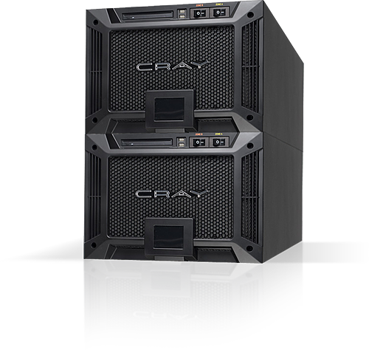
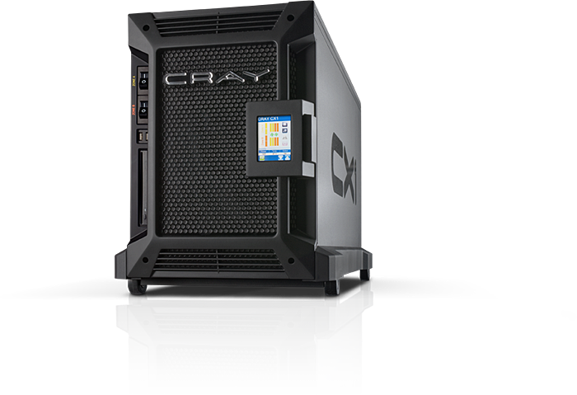
Pedestal Or Rack Mount
or

Slide 24
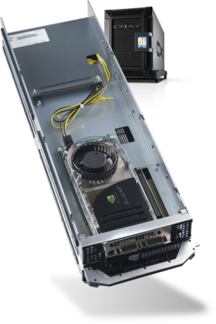


Visualization Options
Quadro Solution | Application Areas | Processor (CUDA) Cores | Memory
Quadro FX 5800 | 4D Seismic Analysis 4D Medical Imaging | 240 | 4GB
Quadro FX 4800 | Digital Special Effects High end post processing Product Styling | 192 | 1.5GB
Quadro FX 380 | Basic HPC visualization | 16 | 256MB

Slide 25
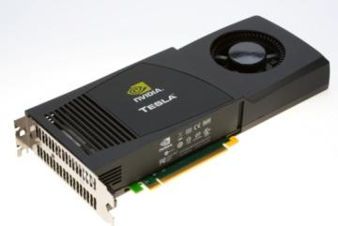

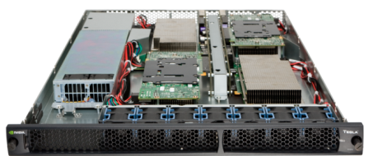
GPU Acceleration Option
Tesla C1060 GPU Board
Tesla S1070 1U System
GPUs | 1 Tesla GPU (Internal) | 4 Tesla GPUs (External)
Single Precision Performance | 933 Teraflops | 4.14 Gigaflops
Double Precision Performance | 78 Gigaflops | 346 Gigaflops
Memory | 4 GB | 4 GB/GPU
Cray CX1 Capacity | Up to 4 per chassis (internal) | Up to 4 per chassis (external, rack mount only)

Slide 26
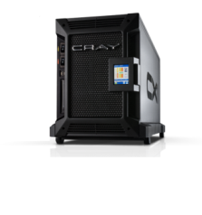

SMP Virtualization
APP
OS
APP
OS
APP
OS
APP
OS
APP
OS
APP
OS
APP
OS
APP
OS
APP
OS
Break the problem to fit the hardware
One system to manage
Single node eliminates cluster management
Single Operating System
Avoid cluster file systems
Hide Infiniband complexities

Slide 27

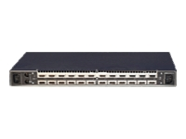
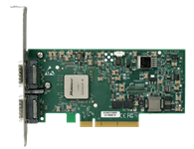


SMP Virtualization
Cray CX1 Compute Blades
Processors speed/amount or memory amount doesn’t have to be same across all boards
Head Node with Internal IB Switch
InfiniBand Interconnect
vSMP Foundation™ Devices
The flash-devices plug into the boards and used as bootable device. vSMP Foundation is booted to present an aggregate coherent view to the OS
A single high-end Intel based SMP system with up to 768GB of shared memory – Easy to manage and use!

Slide 28
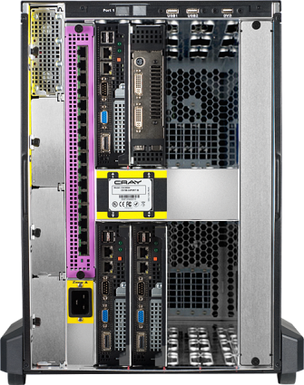
Cray CX1-LC
The CX1-LC is a “Light Configuration” system with a modified chassis to reduce cost for smaller configurations.
  Supports up to 4 compute blades.
  Can support up to 6 blade slots (depending on configuration)
Can be upgraded to “standard CX1” (i.e. 8 blade slots)
Includes blade options which offer additional cost savings.
  Removed interconnect features which are not required on smaller configurations
The Cray CX1-LC delivers an entry level price of around $12,000 with well configured systems at around $20,000

Slide 29




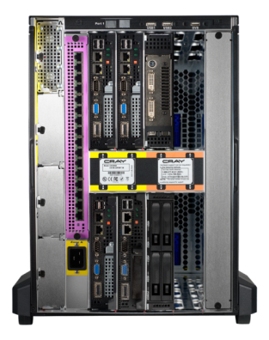


Cray CX1-iWS Integrated Workstation Solution
Shared Storage – attached to one cluster compute blade
(Cluster & Workstation)
A CIFS storage blade
  Shared by workstation and cluster
  4TB Unformatted
  RAID 10
Workstation Blade
(Visualization)
Compute Blades
(Cluster)
Workstation Blade
(Visualization)
A Windows HPC Server 2008 Cluster
  3 nodes with 6 Intel Xeon 5500 Processors (up to 2.93GHz)
  Up to 24GB memory per node
A Windows 7 (64 bit) workstation
  Two Intel Xeon 5500 Processors 2.26GHz
  24GB memory
  NVIDIA graphics with GPU acceleration
  Up to two high end monitor outputs
An integrated 16 port Gigabit Ethernet switch
Available Exclusively from Dell

Slide 30
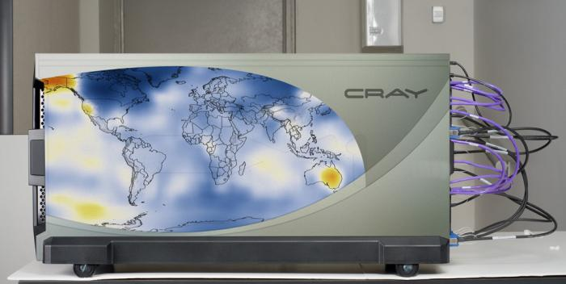
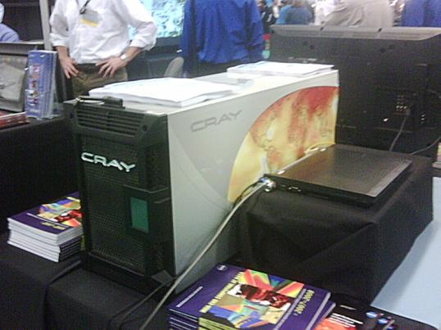
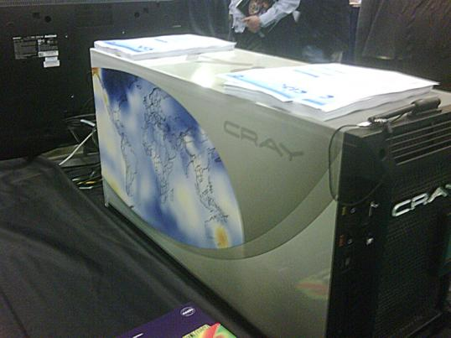
Cray CX1 Custom Chassis Options
Cray CX1 Chassis options include the ability to customize the colors and even create a full custom image if desired
Custom chassis skin
  Logos
  Branding
  Open to imagination…
Inexpensive customization option

Slide 31
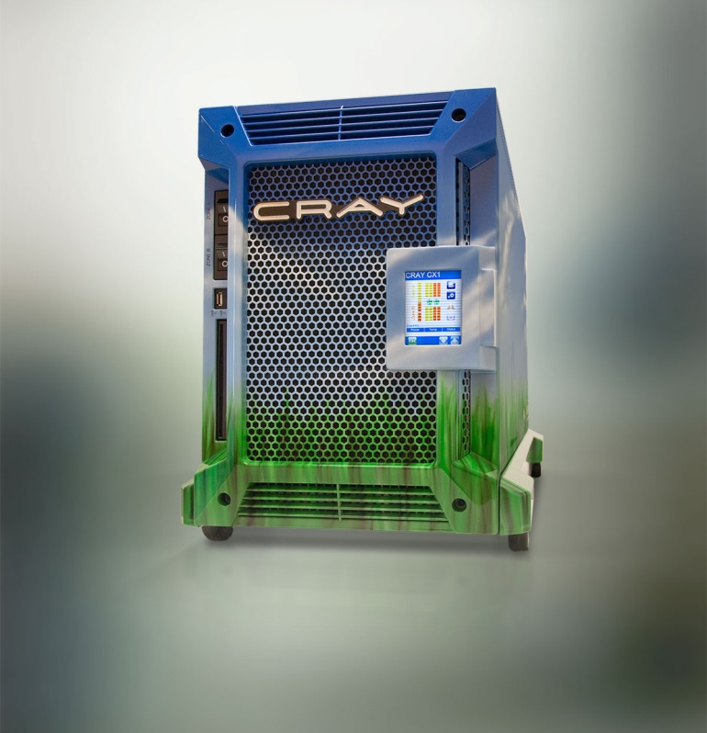
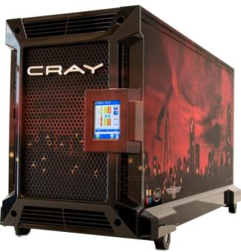
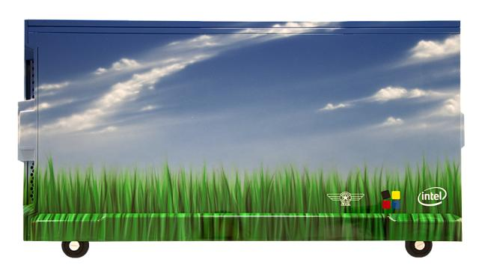
Cray CX1 Custom Chassis Options
Cray CX1 Chassis options include the ability to customize the colors and even create a full custom image if desired
Full custom painted chassis
  Logos
  Branding
  Open to imagination…

Slide 32


Cray CX1 Performance Example
ANSYS FLUENT 12.0 “Truck_Poly_14m” Scaling Results
External flow over a truck with polyhedral mesh 14M cells, DES turbulence, segregated implicit solver
Leading System/Linux/Nehalem
Cray CX1/Linux/Nehalem
Cray CX1 scaling is excellent to 64 cores with InfiniBand
Cray CX1 Configuration as tested:
Rocks+/Redhat EL 5.3
8 compute blades
Intel X5570, 2.93GHz
24 GB per blade
InfiniBand interconnect

Slide 33
Cray CX1-iWS Performance Example
ANSYS FLUENT 12.0 “Truck_Poly_14m” Scaling Results on Cray CX1-iWS
External flow over a truck with polyhedral mesh
14M cells, DES turbulence, segregated implicit solver
Cray CX1-iWS
Windows HPC Server 2008
3 compute blades
Intel Xeon X5570, 2.93GHz
24 GB of memory per blade
GigE interconnect
CX1-iWS scaling is excellent
5.8X speed up going from 4 to 24 cores
Intel X5570 (Nehalem) Comparison – Dec’09

Slide 34

Easy To Maintain
The Cray CX1 comes with a three year warranty for parts and service
Cray provides next day business hours on site support
Real people providing real service, vs. other vendors “return to depot” type service
Cray’s goal is to give you high product reliability coupled with strong customer service

Slide 35
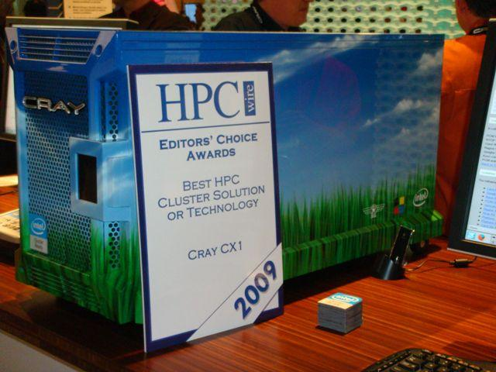
Cray CX1 Recognition
Cray CX1 Wins HPC Wire “Best HPC Cluster Solution” for 2009

Slide 36




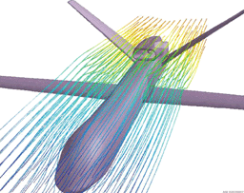
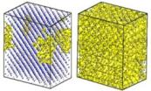
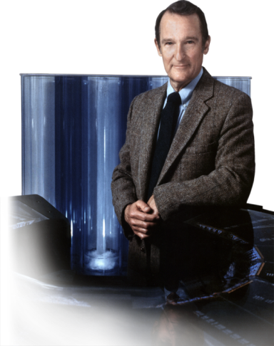

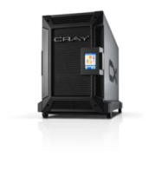

Cray is Supercomputing!
Cray created the Supercomputer industry in 1972 with the Cray 1
Over 35 years experience with the “grand challenges” of science and simulation
Today Cray systems are among the most powerful in the world
  ORNL’s Jaguar was the first system to run real world applications at over a petaflop sustained performance
The Cray CX1 captures that legacy to provide power and performance to a much broader community of users

Slide 37



















Example CX1 Customers

Slide 38
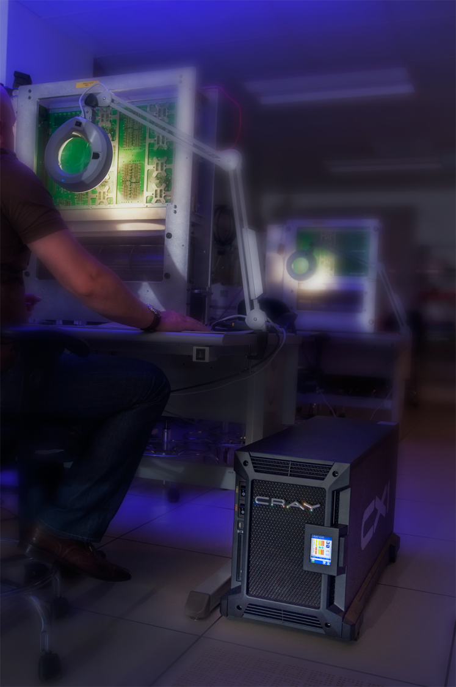
The Power Is In Your Hands
The power user needs a powerhouse tool to get the job done
The Cray CX1 is that powerhouse, with compute, storage, GPU, switches and visualization all integrated in one affordable, attractive office installable unit
Cray represents the pinnacle of power and performance
Small Footprint
Huge Performance It’s a Cray!

